Slide 1
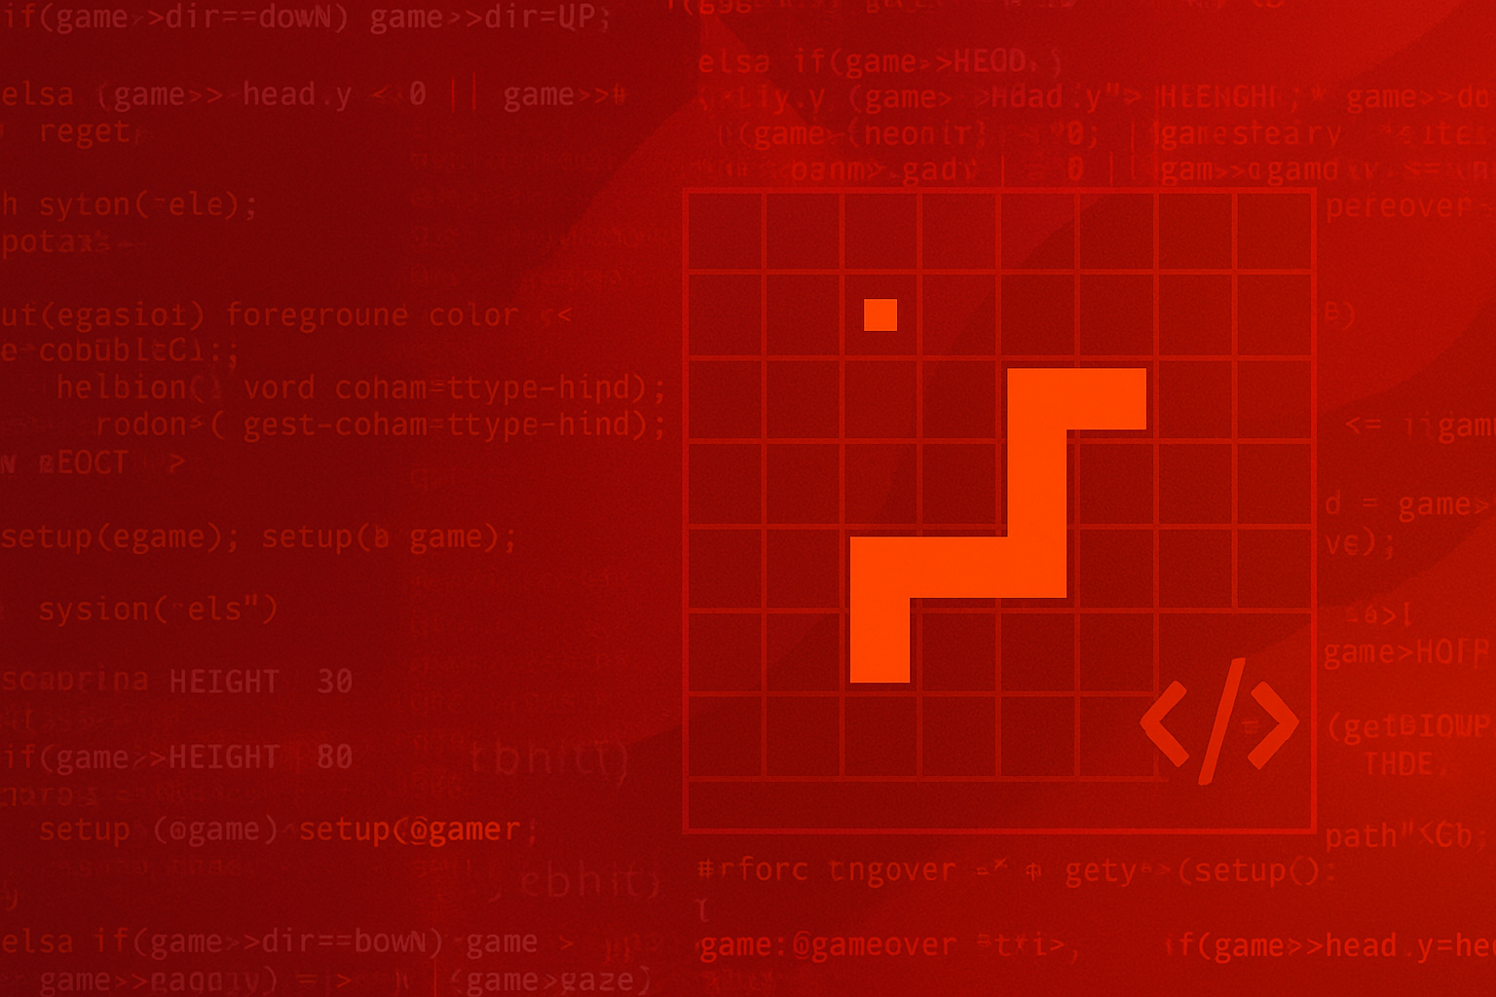


SNAKE GAME
GROUP – 4
Course code: CSE115.4

Slide 2
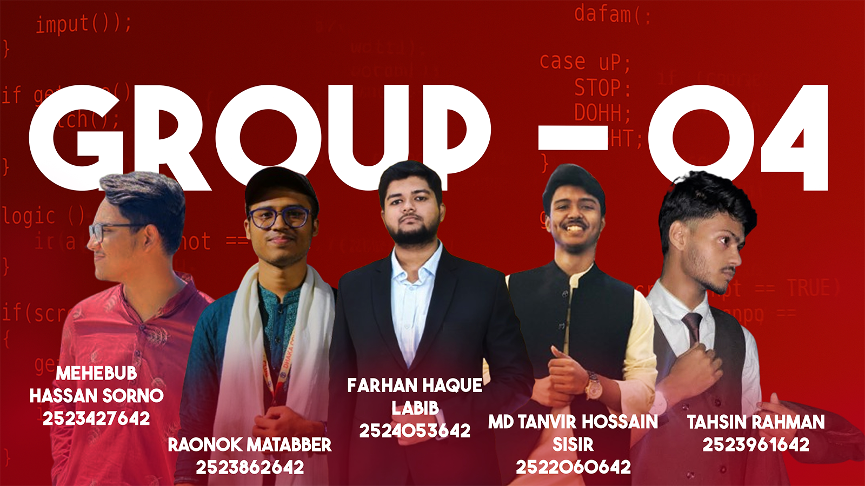
WHAT IS A SNAKE GAME?

Slide 3
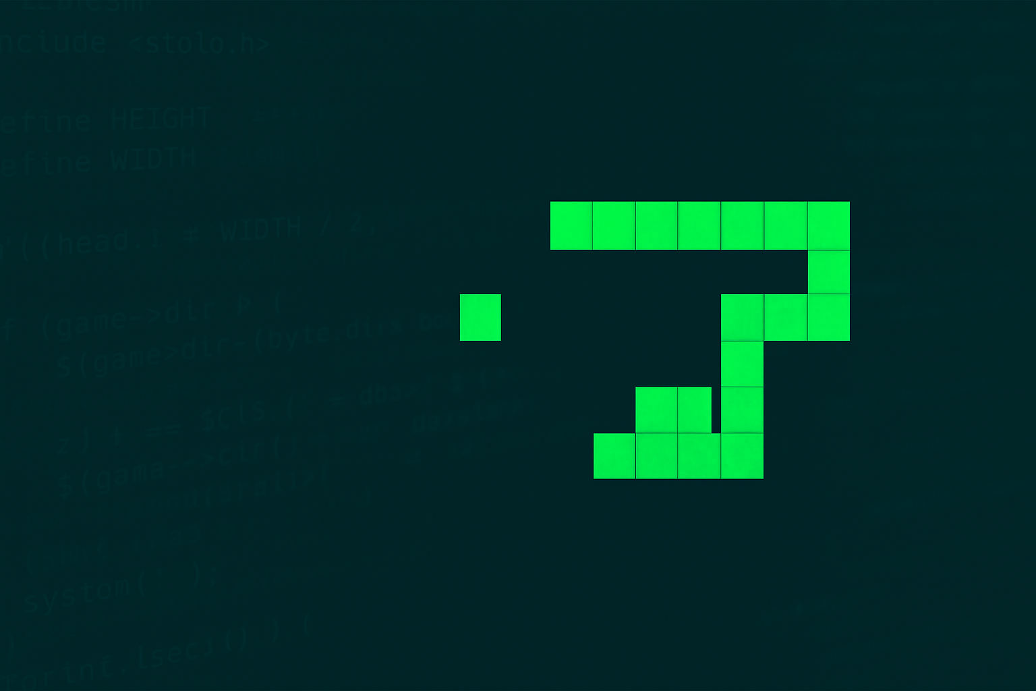
WHAT IS A SNAKE GAME?
Control a snake to eat food and avoid crashes.
Raonok, labib, Tanvir, Tahsin, mehebub

Slide 4
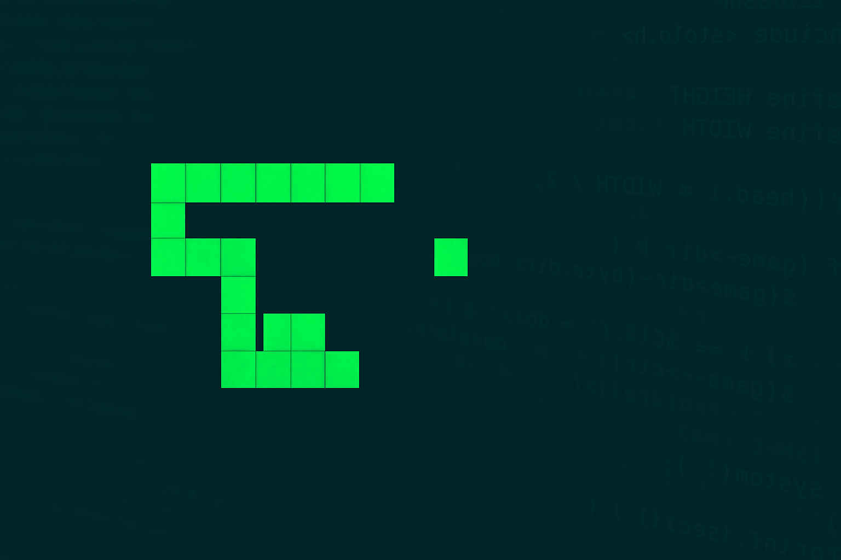
WHAT IS A SNAKE
GAME?
Why we choose it
Control a snake to eat food and avoid crashes.
Raonok, labib, Tanvir, Tahsin, mehebub

Slide 5

Why we chose it
Classic Programming Logic Demo
Real Time Input
Simple Graphics
Raonok, labib, Tanvir, Tahsin, mehebub

Slide 6

Why we chose it?
Classic Programming Logic Demo
Real Time Input
Simple Graphics
Implement smooth snake movement
Add food spawning & scoring
Use clear modular code & GitHub version control
Handle self-collision logic
Raonok, labib, Tanvir, Tahsin, mehebub

Slide 7

Implement smooth snake movement
Add food spawning & scoring
Use clear modular code & GitHub version control
Handle self-collision logic
OBJECTIVES
Setup
Draw
Input
Logic
Repeat
Raonok, labib, Tanvir, Tahsin, mehebub
System Architecture

Slide 8
System Architecture
Setup
Draw
Input
Logic
Repeat
Raonok, labib, Tanvir, Tahsin, mehebub

Slide 9
System Architecture
Basic movement works
Wall collision detection
POSITION
GAMESTATE
Key structs
Raonok, labib, Tanvir, Tahsin, mehebub

Slide 10
System Architecture
Basic movement works
Wall collision detection
Current Progress
Raonok, labib, Tanvir, Tahsin, mehebub

Slide 11
Food generation & self-collision in progress
Future
work
Raonok, labib, Tanvir, Tahsin, mehebub

Slide 12
GitHub repo active
Demo screenshot
Future
work
Raonok, labib, Tanvir, Tahsin, mehebub

Slide 13
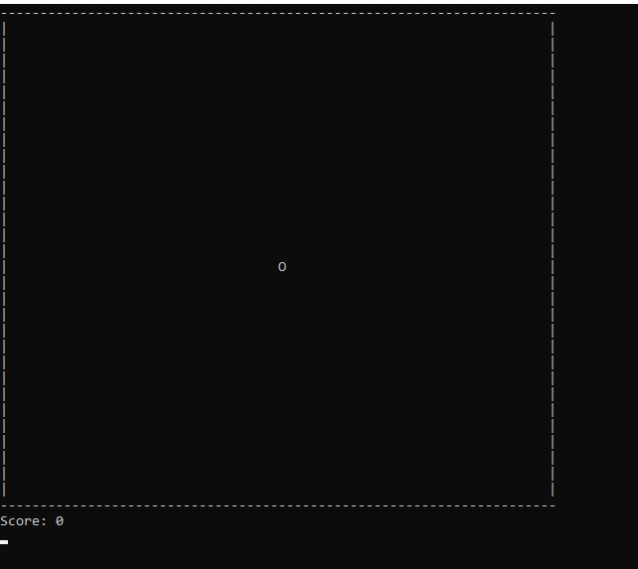
Demo screenshot
Raonok, labib, Tanvir, Tahsin, mehebub

Slide 14
Console flickering
with system("cls")
Demo screenshot
Challenges
Smooth input with _kbhit() & _getch()
Body segment tracking
For self-
collision
Raonok, labib, Tanvir, Tahsin, mehebub

Slide 15
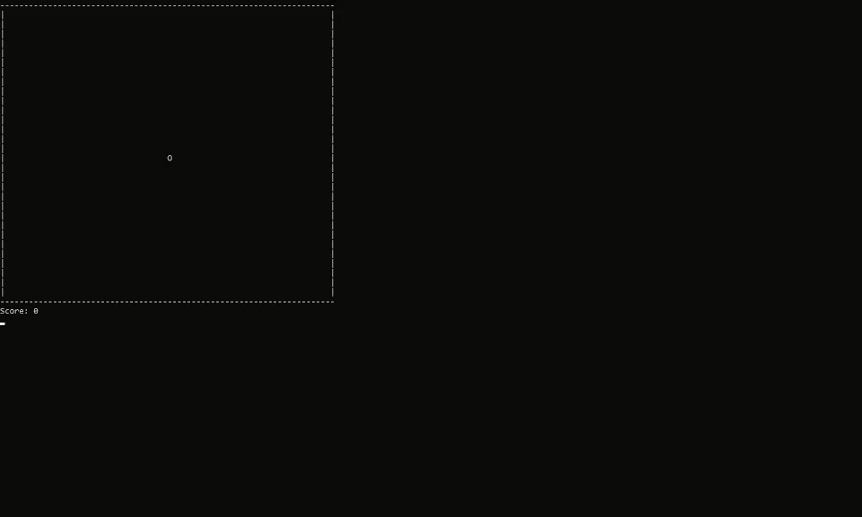
Smooth input with _kbhit() & _getch()
Challenges
Raonok, labib, Tanvir, Tahsin, mehebub

Slide 16
Next steps
Implement random food
Prepare final report
Grow snake on food
Finalize self-collision
Raonok, labib, Tanvir, Tahsin, mehebub

Slide 17
Thank you
Raonok, labib, Tanvir, Tahsin, mehebub

